Slide 1
Inside the murder box
Rowland Atkinson and Tom Rodgers
Department of Sociology
University of York

Slide 2
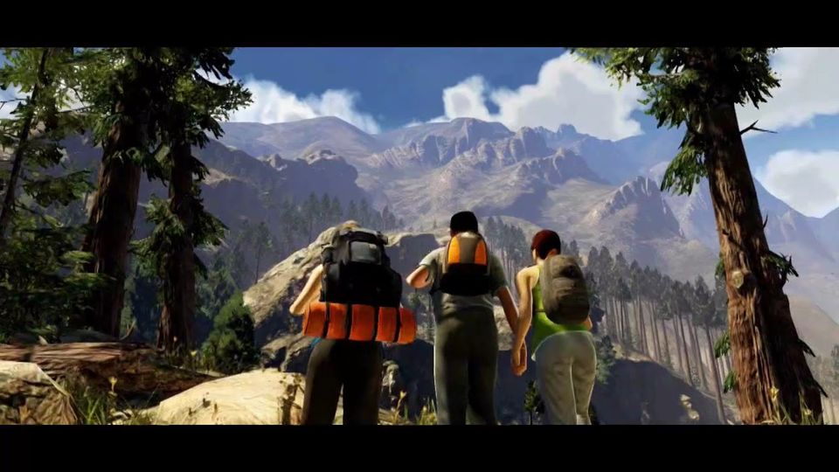
Aims
To map the lure and cultural place of ‘murder games’:
  Release of a publicly sanctioned conduct insider murder boxes
  Facilitation and draw of zones of social exception
  Role of private experiences combined with mass cultural positioning

Slide 3
Stripping away the veneer or civility
‘Men are not gentle creatures…their neighbor is for them not only a potential helper or sexual object, but also someone who tempts them to satisfy their aggressiveness on him…to humiliate him, to cause him pain, to torture and to kill him (Freud, Civilisation and its Discontents)
Gerhardt’s Selfish Society:
  Capitalism produces social conditions of hardship and absence of warmth

Slide 4
Models of media exposure and social impacts
Cultivation Theory focuses on ‘aggregate effects of massive and long-term exposure of publics to centrally produced, mass distributed media systems of stories’ (Gerbner et al. 1994)
  Effect of continued immersion in film, video games, news media, TV dramatisations
  What do we cultivate under conditions of bespoke media content?

Slide 5

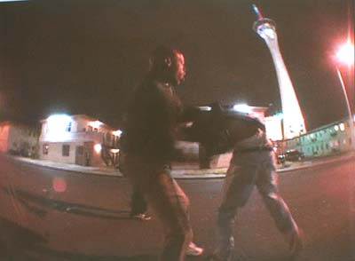
Torture, execution and political killings
Marketed aggression and machismo
Horror becomes a carnival for
the affluent
Bumfights

Slide 6
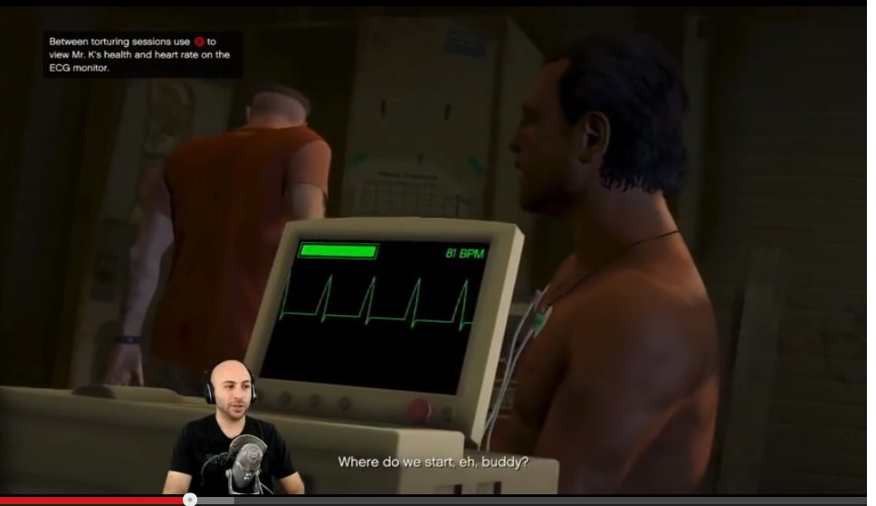
Script closure – Torture in GTA V

Slide 7
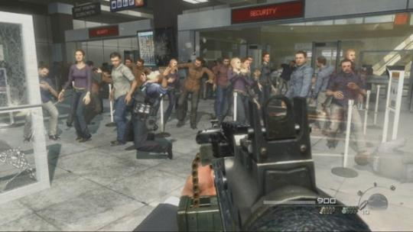
No Russian On Wikileaks from Iraq
Call of Duty: Modern Warfare
…it instantly reminded me of a videogame, specifically the game that currently sits inside my Wii - Call of Duty: Modern Warfare. If you're unfamiliar, or prefer not to spend your spare time sniping imaginary terrorists…your job is to kill everything that moves.
Douglas Haddow guardian.co.uk, 7 April 2010

Slide 8
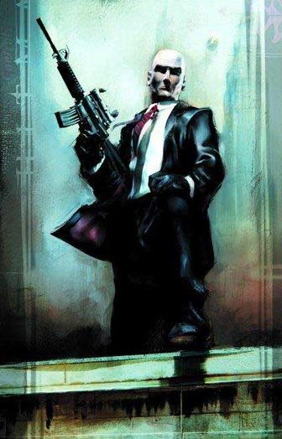
The murder game
A focus on planned killing i.e. distinct from ‘shoot-em ups’
Suspension of social physics
Cathartic space: Release of desire and rage
Murder box:
  All is permitted
  Narrative impels subjugation and complete destruction of others
  Private screen space permitted by new ICTs
  Films, tourism, games, pornography

Slide 9
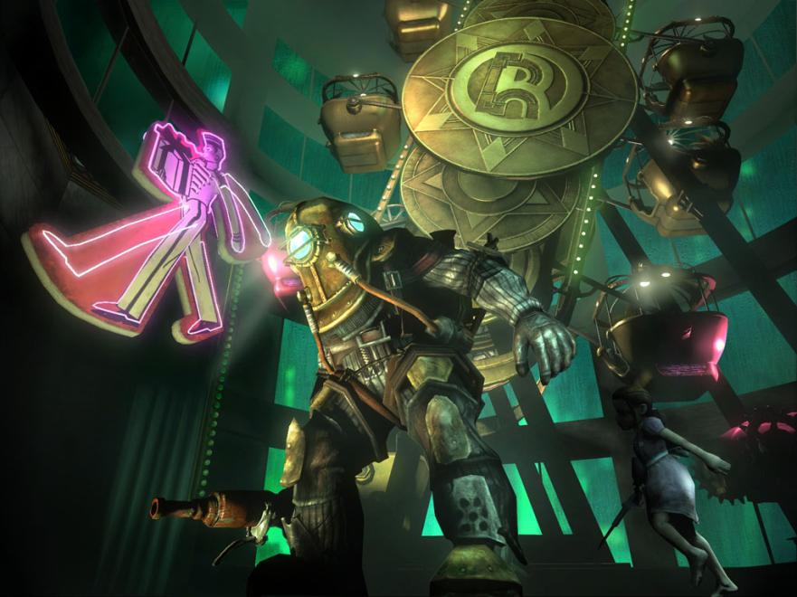

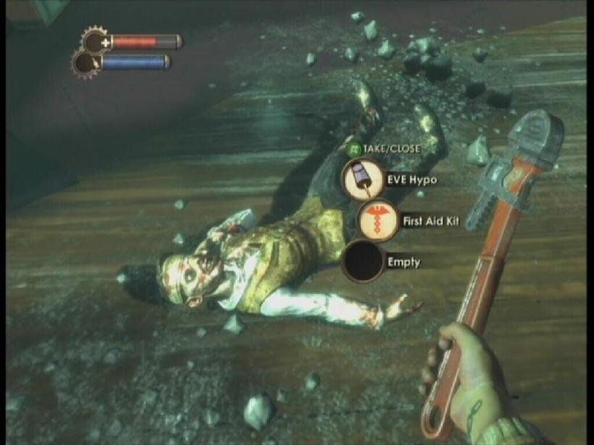

Slide 10
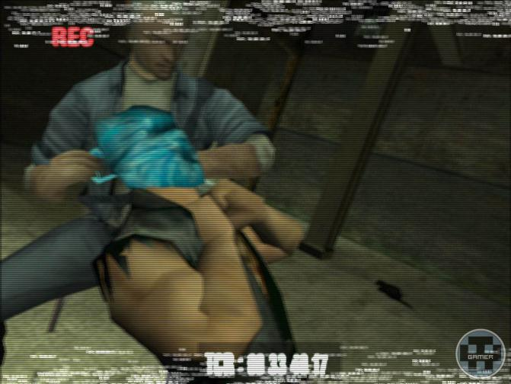
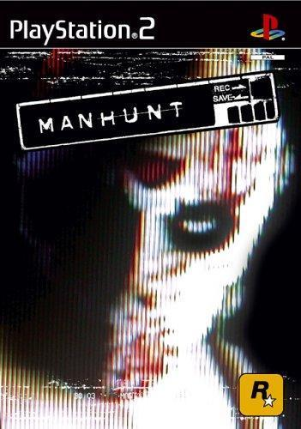
Manhunting

Slide 11
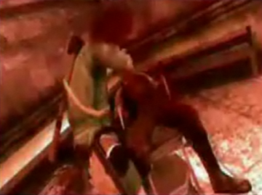
Plotline: Making of snuff movies, surviving attacks
Othering to legitimate the use of extreme violence:
  "These streets are being patrolled by gangs. They're scum -- just like you, and they're here to hunt you down and cut you up.”
‘BBFC judgment: Contains strong bloody horror, gore, violence and sustained terrorisation …Manhunt 2 is distinguishable from other video games by its unremitting bleakness and callousness of tone…which constantly encourages visceral killing… There is sustained and cumulative casual sadism’

Slide 12


Slide 13
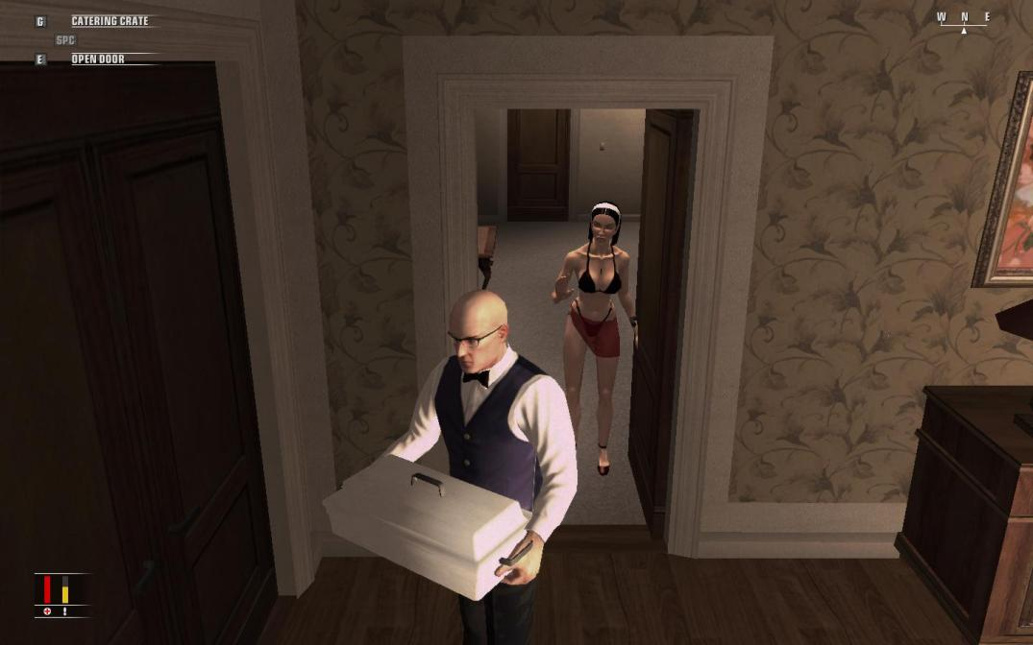
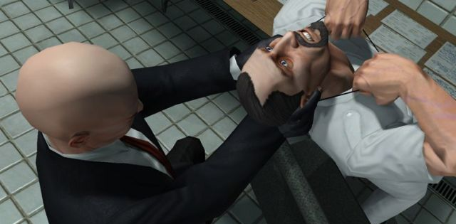
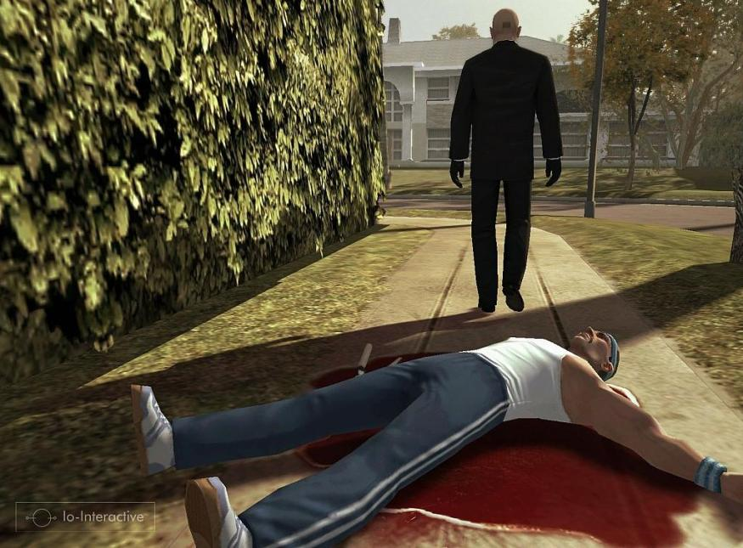

Slide 14
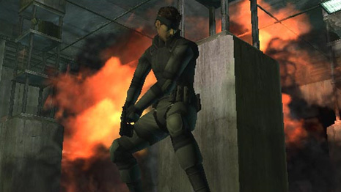
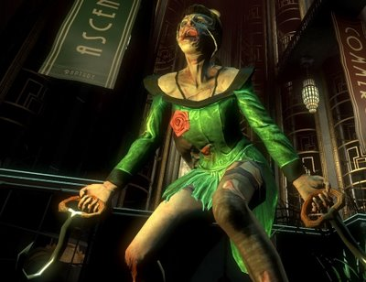
A morbid space - sandboxes of exception
Fantasy spaces in which social physics and morality are rendered secondary
Stealth – guerilla and assassination tactics become key cultural reference points

Slide 15
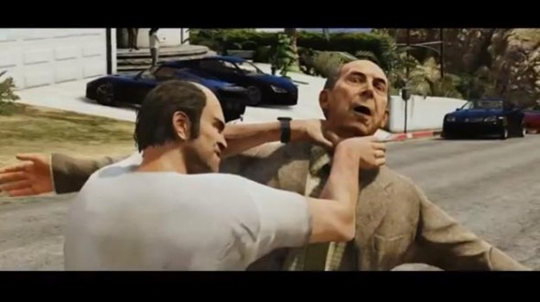
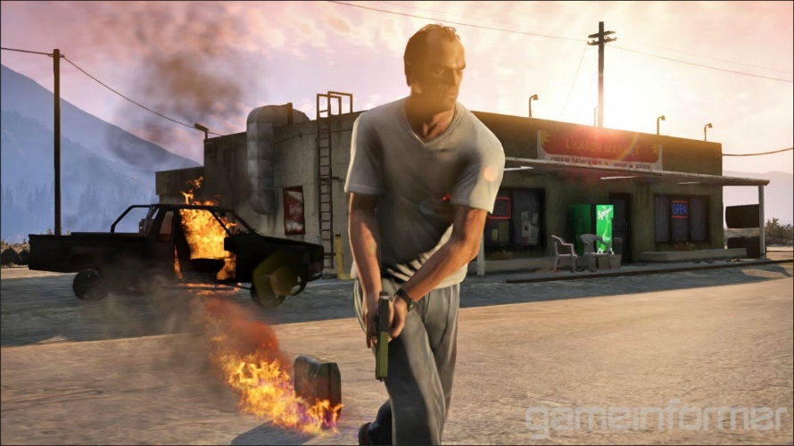
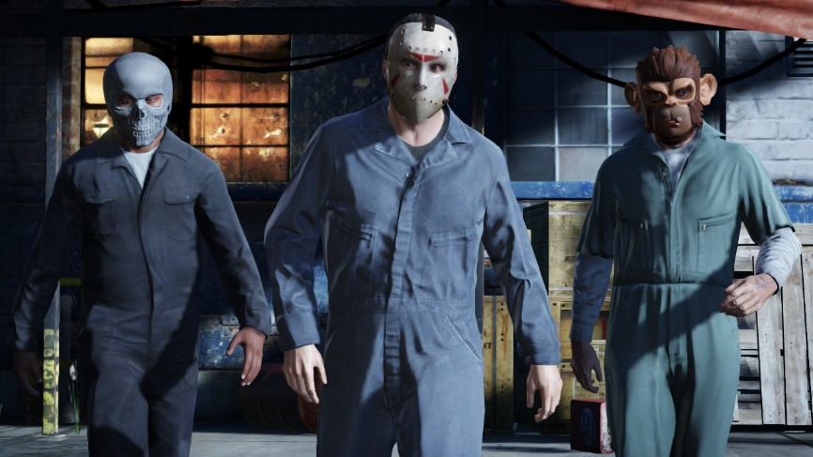
Inside the murder box
Grand Theft Auto
  Life is cheap – in narrative terms, and within game structure (The bum tunnel)
Los Santos as simulated camp - Brutality is demanded, or explored through ‘play’
Blurring of in-game and out-game lives – ludodrome
  Saviano on popular culture’s impact on Mafiosi – impacts are not restricted to gamespace

Slide 16
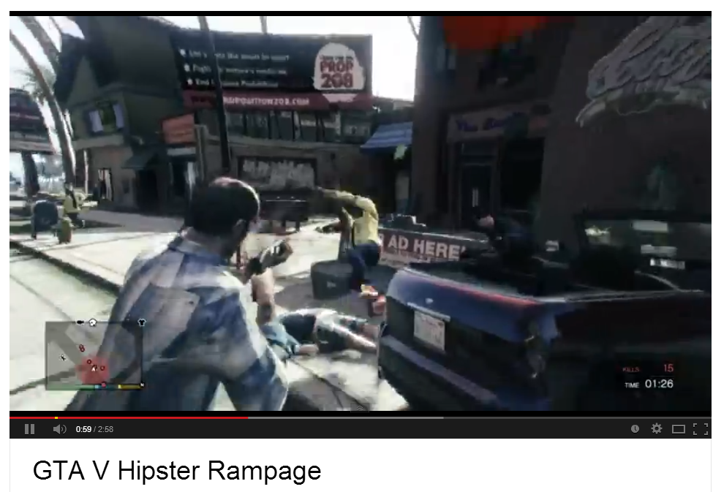
http://www.youtube.com/watch?v=OpvkN85xXV4

Slide 17
Other zones of social suspension
Extreme pornography – mediation of desire through harm and coercion (rape trade, cells), Japanese Rapelay game
Film – real and ‘real’ snuff movies – Hostel, Saw, Vacancy
Ballard ‘elective psychopathologies’:
  Individual desires, impulses and experimental perversities are re-aggregated through networks

Slide 18
Conclusion
Spaces within certain videogames open possibilities for unchecked social exception; new forms of ‘camp’
A compulsive undertow of horror: Cultural contradictions of blasé attitude to death / ‘real’ and chilling representations.
Media harnesses desires and experimental attitudes

Slide 19
End
rowland.atkinson@york.ac.uk

Slide 20
As I broke into the sexual deviant night club and slowly crept up on unsuspecting leather face while he was taking a piss not caring about anything I got all excited that I was about to brutally murder him and half act it out on the Wii. Then with my motions matching those on the screen I bashed his head against the wall (a forward thrust of just the Wiimote) then knocked him down (a side swipe with the Wiimote) then picked up the Toilet Tank cover lid (a lifting motion with Wiimote and the nunchuck) and finally the bashing of his skull open with that lid (Violent downward trusts with the Wiimote and nunchuck)…..This game creates bloodlust and I almost understand it being banned at first and it still being banned in the UK. In closing I love this game (and by game I mean tool to vicariously act out secret desires)
Gamer review of Manhunt 2, www.gamefaqs.com

